Slide 1
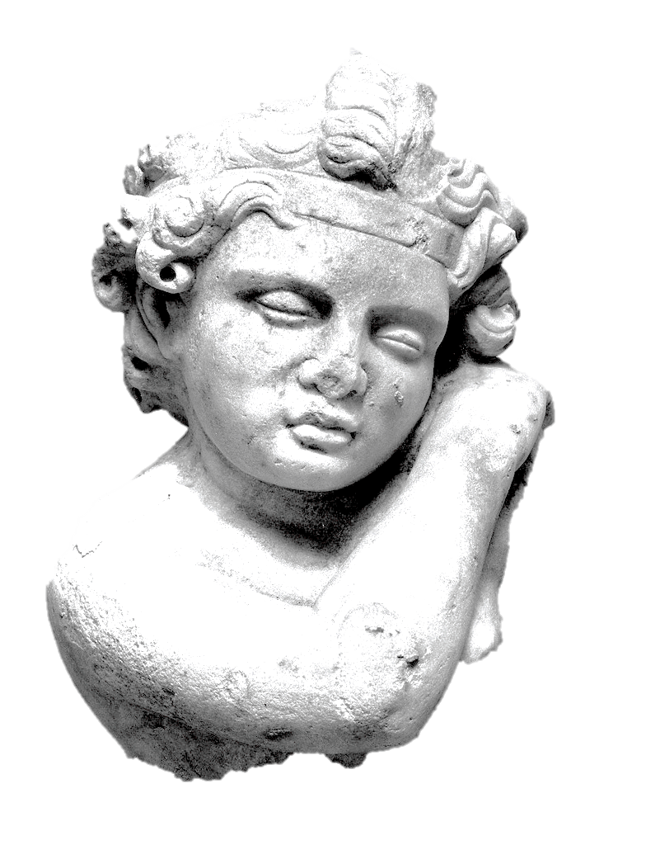
«γράφει τά παιδία;»
(do children write [graffiti]?)
In search of children and juveniles through their graffiti.
anASTASIA Koutsoudaki
Proffessors: A. Kapetanios, V. Vaiopoulos, M. Mataragga
Athenian Agora, S 902
Notes:
Buongiorno! (1) my name is Anastasia Koutsoudaki and my thesis is about ancient graffiti and their social dimension. My professors are Mr. Kapetanios, Mr. Vaiopoulos and Mrs. Mataraga from the Ionian University of Corfu and the Kapodistrian University of Athens, Greece.
Today I will try to investigate one particular aspect of ancient graffiti that has to do with children as graffitists. So, the main question is: “Did children and juveniles in antiquity write graffiti?” Or in ancient Greek, if you prefer: «τά παιδία γράφει;» / (do children write [graffiti]?)

Slide 2
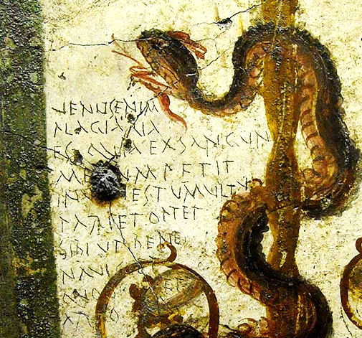
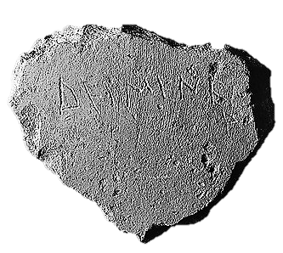
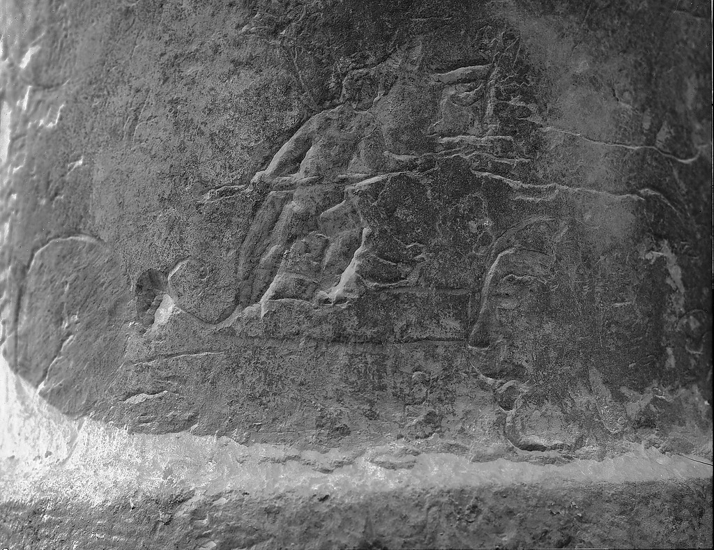
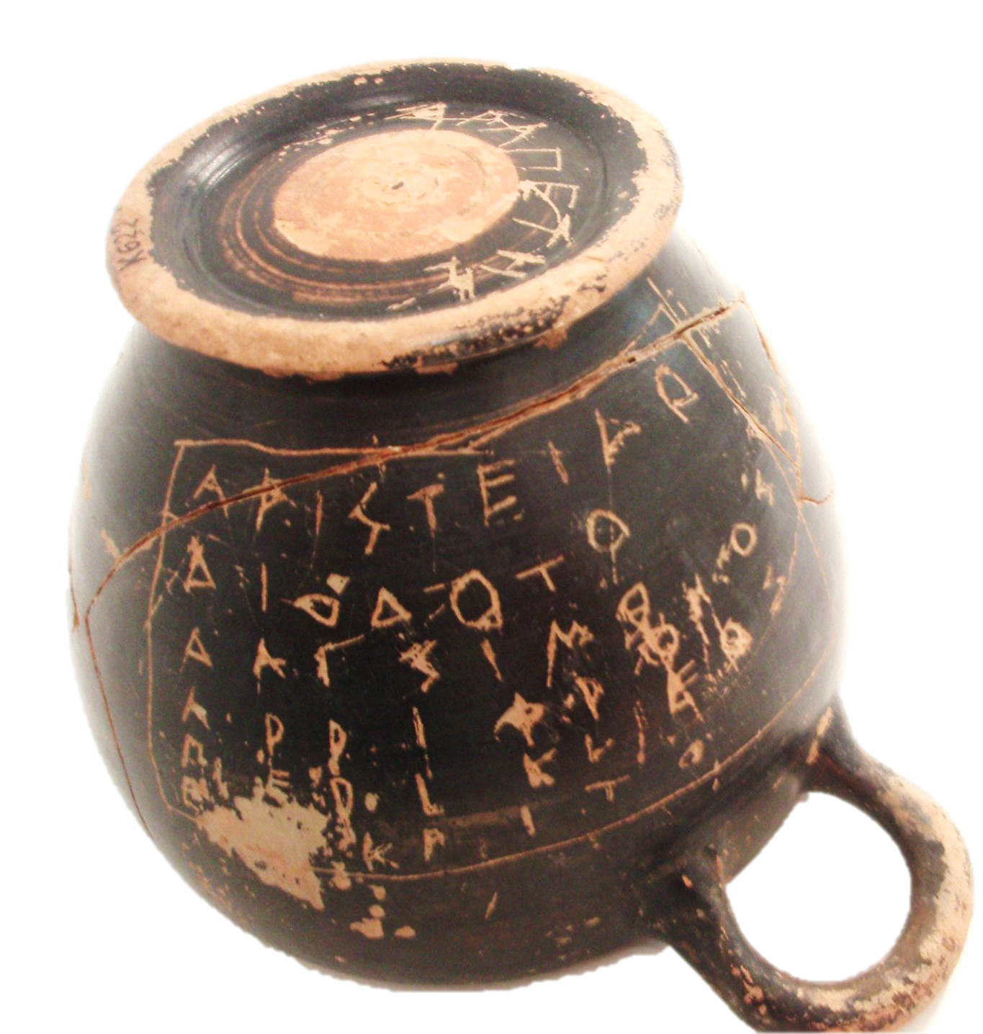
What do we mean with the term “ancient graffiti”?
inscriptions or designs
engraved or written with private initiative
on surfaces not intended to receive them
Pompei, Casa di Hercules, CIL 4 1410
Athenian Agora, P 4794
Athens, Kifisia collection, Κ 622
Athenian Agora, SE Stoa column, A 2848
Notes:
The term "ancient graffiti" has multiple definitions. It mostly refers to
- inscriptions or designs engraved or written
- with private initiative
- on surfaces not intended to receive them.
No matter their technique, their content or their date, if they fulfill all these three criteria they can be characterized as graffiti.
Many take the form of engravings made on walls of both public and private buildings (2a)
Others are made on everyday objects or ostraca (2b)
Some are texts, others are figural, some are both (2c)
Most ancient graffiti come from the archaeological record. They are written on a material surface and together, graffiti and written surface, form an inseparable material unit regarded as an archaeological find.

Slide 3

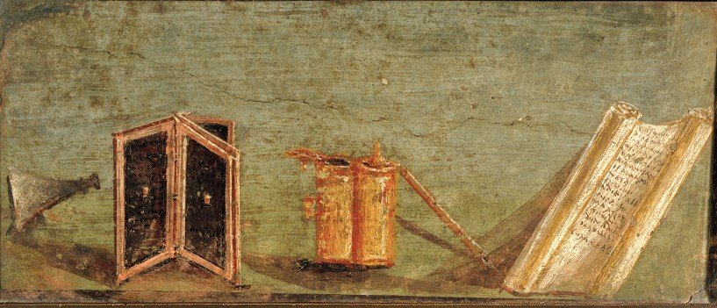
Fictional graffiti literary graffiti found in ancient texts
Wall painting from Pompeii, CIL 4 1173
Notes:
However, not all ancient graffiti are material. Some are only fictional. Graffiti habit was so common that quite often ancient Greek or Roman writers refer to them in their works. These are only testimonies of graffiti. They may have been written sometime in the past or they may just be products of fictional imagination. Ancient texts usually provide us with a more or less complete record of who, why, under which circumstances they were made and what was their impact to the people that read them.
Within this very broad graffiti universe, I restricted my research on graffiti fictional or archaeological made on walls, portable objects and ostraca from Greece and Italy dating from the 8th c. B.C. up to 4th c. A.D.

Slide 4
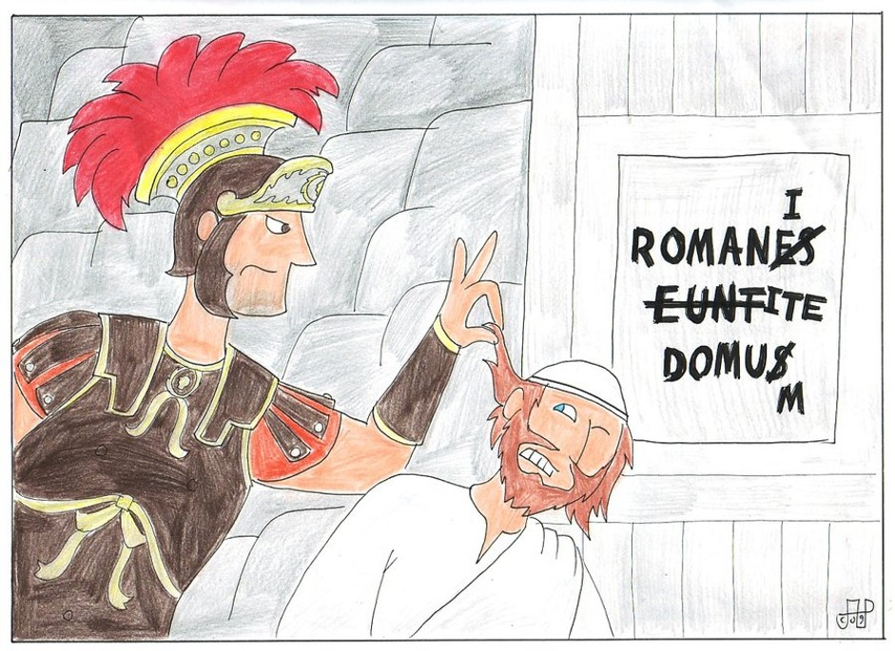
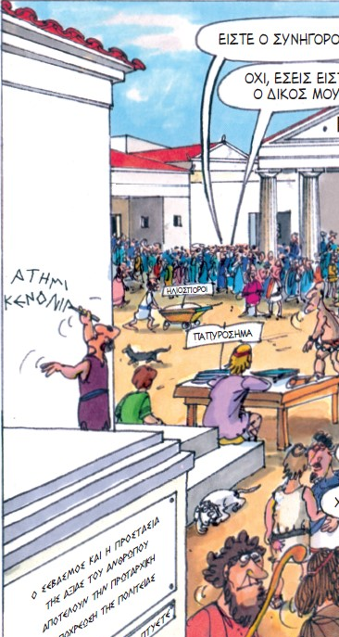
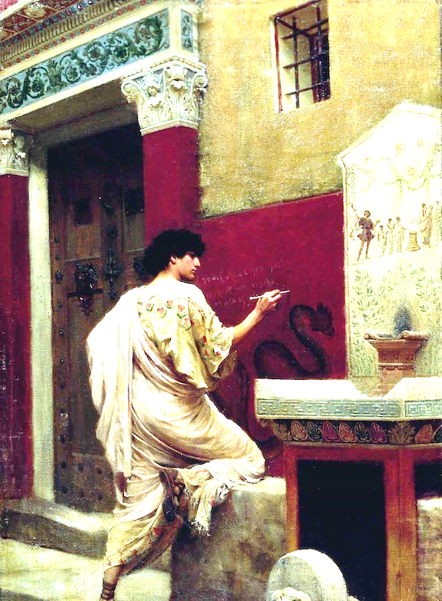
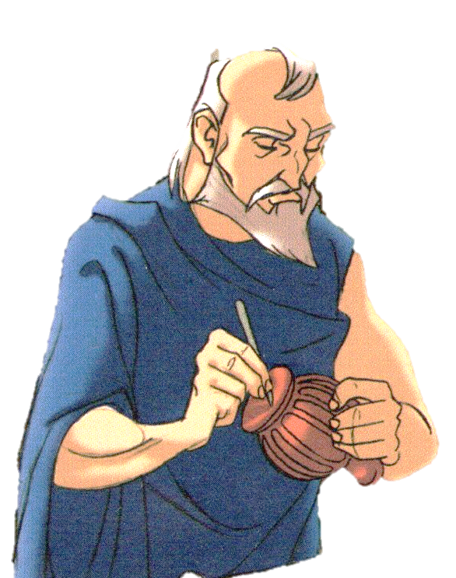
Who were the ancient graffiti writers?
Life of Bryan, 1979
Monty Pythons
The walls of Pompeii, 1885
Stefan Bakalowicz
In Athenian Agora
Aristaphanes comix, The wasps, Medusa Edition. 2000
Sculptor Phidias, making a graffiti
From ……. Comix
Notes:
My aim is to better understand the social dimension of the graffiti habit. Particularly I am interested to “meet” the ancient graffiti writers, some of the main questions I attempt to answer are:
Who were the people that made graffiti?
Were they only men? Were they only adults?
Did they come from a particular social group?
Could a free man, a poor man, an aristocrat etch. make a graffito with the same ease?
Most of modern representations of ancient graffiti writers from 19th c. paintings (3a) to Monty Pithons films (3b) of the late 70s and modern comix (3c) (3d) represent the graffiti writers as male adults. These representations show a false aspect of antiquity that is influenced by modern graffiti and modern graffiti writers.

Slide 5
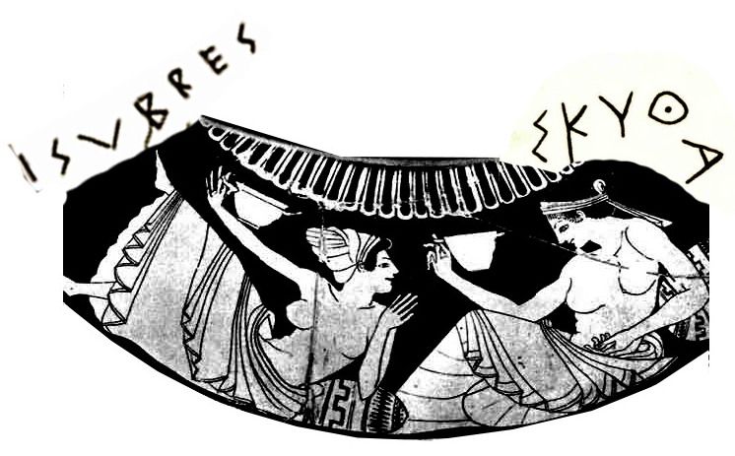
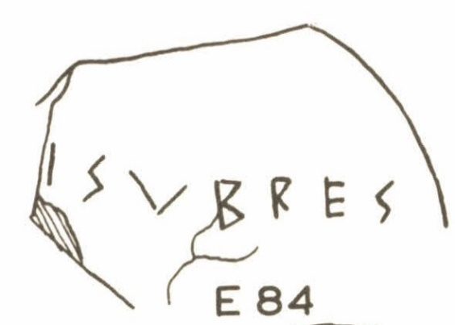
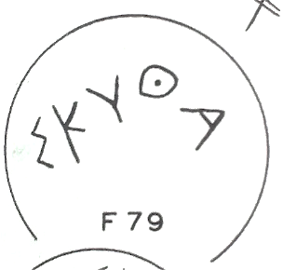
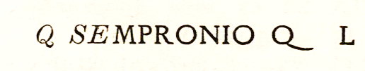
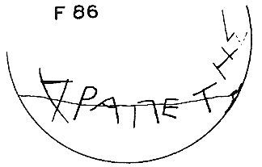
Graffiti of marginal social groups
Pompeii, 1st c. B.C (CIL 4 1429,)
Athenian Agora, 5th c. B.C. (Ρ 5109, P 21399)
Athenian Agora, , 5th c. B.C. (L 3088)
Notes:
In antiquity graffiti writers seldom gave any information about themselves. We investigate their identities, their gender or any other information about them through archaeological or linguistic approaches. In fact many graffiti are now positively linked to marginal social groups including
(4a) Women:
female names curved on 5thc. BC Athenian drinking vessels are attributed to courtesans – probably they curved their name on their own vessels that they used at banquets. Also their names are indicative of their profession. Sisymvres, and its nick name Sisymvrion, was a common name for a courtesan, whereas that of Skytha is indicative of a Scythian origin. Male Scythian slaves belonged to the city and of the same origin was attributed to the mythical amazons. Probably, the real name of Skytha was forgotten in favor of her exotic ethnic origin.
(4b) Slaves:
«Δραπέτης»/ “the runaway slave”, curved his name on a drinking cup of the 5th c. B.C from the Athenian Agora. Judging from his name he was a runaway slave, whose real name was also forgotten in favor of a nick name that is probably descriptive of his past
(4c) Freed people:
Q(uintus) Sempronius scratched his name along with his idedity, and the latter “L” , that stands for “libertus” on the walls of Vicoletto de Mercurio in Pompeii. So Sepronius was a freed person.
These are only three of the numerous examples that prove that graffiti habit was not a closed activity linked only to free male individuals, but literally a habit that everyone could exercise once or more times in his life. For example “Drapetis” curved his name on another drinking cup found Athens, Kifissia dating to the same period, 5th c. B.C.

Slide 6

When did the graffiti habit begin?
?
?
?
?
?
?
?
?
Notes:
So, if everyone in antiquity could potentially become a graffiti writer, when did this activity begin?
Was it a means of communication limited only to adults or was it a habit that accompanied man from a very early age?
Did children and young people make graffiti like adults?
And if they did so, when did they begin making graffiti?
What kind of graffiti did they make?
To answer these questions, I turned to two main sources of evidence:
1. Literary testimonia, written references of graffiti made by Greek and Roman writers
2. Material graffiti from the archaeological record.
…and searched for the hand of children and juveniles behind their graffiti

Slide 7
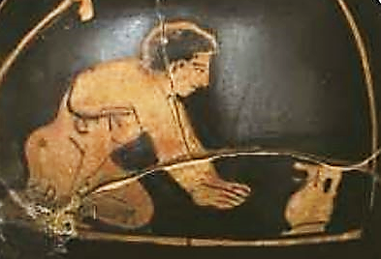
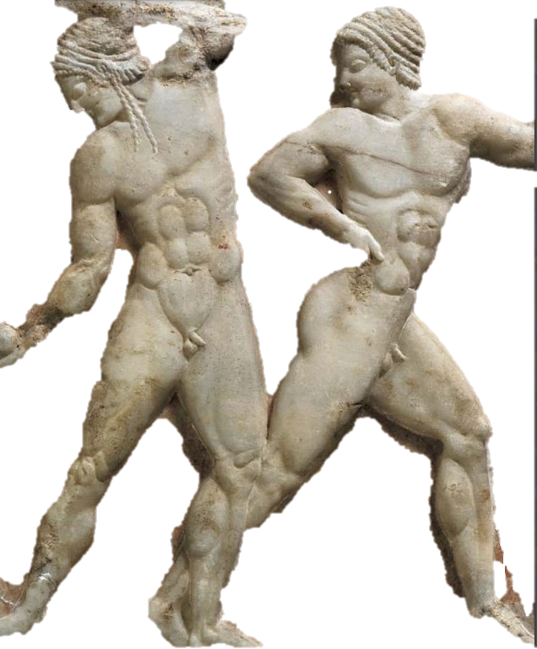
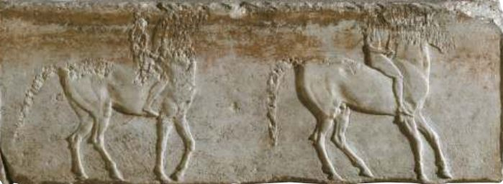
Different stages of childhood
Α. Toddlers
Before learning to write up to 7 years old
B. Juveniles
mostly athletes or students
7-18 years old
C. Almost adults
juveniles on military service
18-20 years old
Athenian Agora, P 21227
Keramikos, Aρ Ευρ 1002
National Archaeological Museum_3476
Notes:
Children do not form a homogeneous group. Toddlers, children, juveniles, adolescents act and think in different ways and their graffiti will also be different reflecting their age, their education level, and the ways they perceive the world.
- Until the age of seven both girls and boys stayed at home and were guided by their mothers, who were their first teachers provided that they were also literate and willing to teach them.
- From 7-14 years old they attended the basic educational level – open for girls too in Rome, and from 14-18 years old boys could continue with their studies provided they had money to pay for it, while girls usually got married at this age.
- From 18-20 years old in Greece and from 4th c. B.C. boys had to spent 2 years in military service.
- Only afterwards and at the age of 20 were they granted full citizen rights and were able to take part in the political scene of their city.
Following this basic age centered educational division I also divided my research into three distinct age groups:
(a) toddlers, (very young children before learning to read or write, before becoming 7 years old) (6c)
(b) Juveniles and adolescents (mostly athletes or students, from 7 until 18 years old) (6b)
(c) Almost adults (youngsters on military service, from 18-20 years old) (6a)
I will begin with graffiti collected form literary sources and proceed with graffiti from the archaeological record.
Unfortunately, authors very rarely refer to children in their works and even more seldom do they refer to their graffiti. To be precise there are only 4 instances

Slide 8
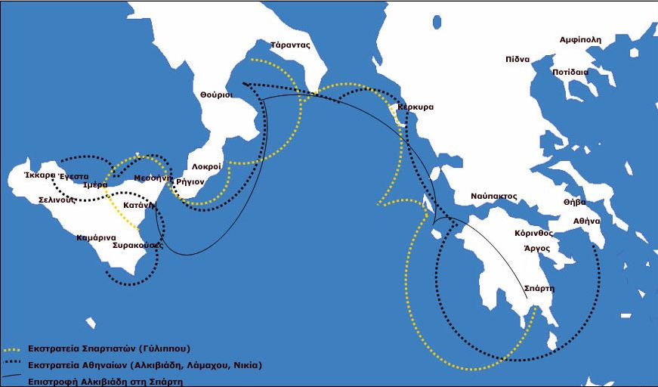
1. Map of Sicily, before 415 B.C.
…the youths in their training-schools and the old men in their work-shops and lounging-places would sit in cluster drawing maps of Sicily, charts of the sea about it, and plans of the harbors and districts of the island which look towards Libya.
(Plutarch, Nicias, 12.1 12.1)
Notes:
Just before the Sicilian expedition (415 B.C.) the citizens of Athens were so excited with the possibility of winning in this war that all of them, youths and people of an older age, drew everywhere the map of Sicily.
…the youths in their training-schools and the old men in their work-shops and lounging-places would sit in cluster drawing maps of Sicily, charts of the sea about it, and plans of the harbors and districts of the island which look towards Libya. (Plutarch, Nicias, 12.1 12.1)
It is one of the very few examples of figural graffiti that can be found in literary texts. Note that both youngsters and old men make the same kind of graffiti at the places where each group spent a lot of time. Youngsters in their training schools, old men in workshops.
.

Slide 9
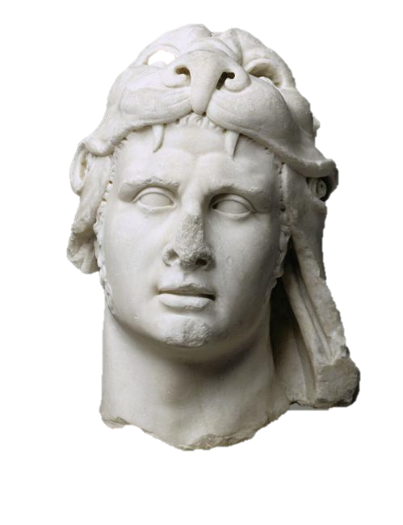

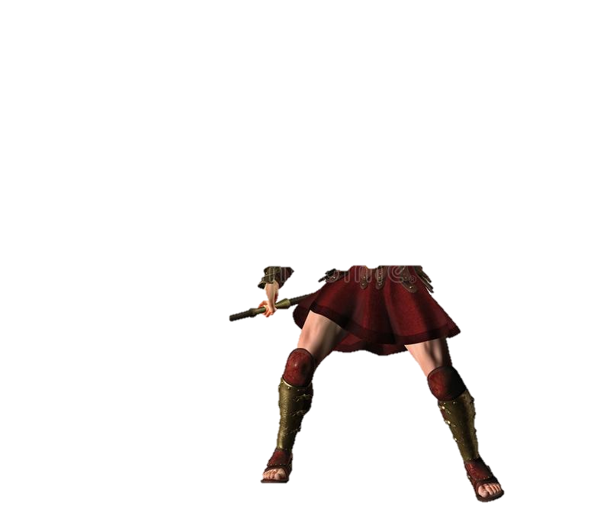
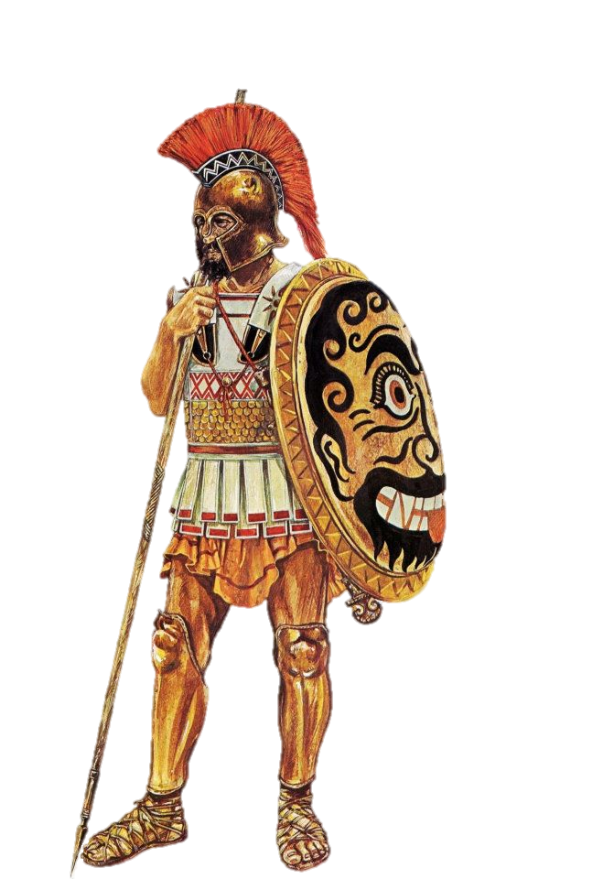
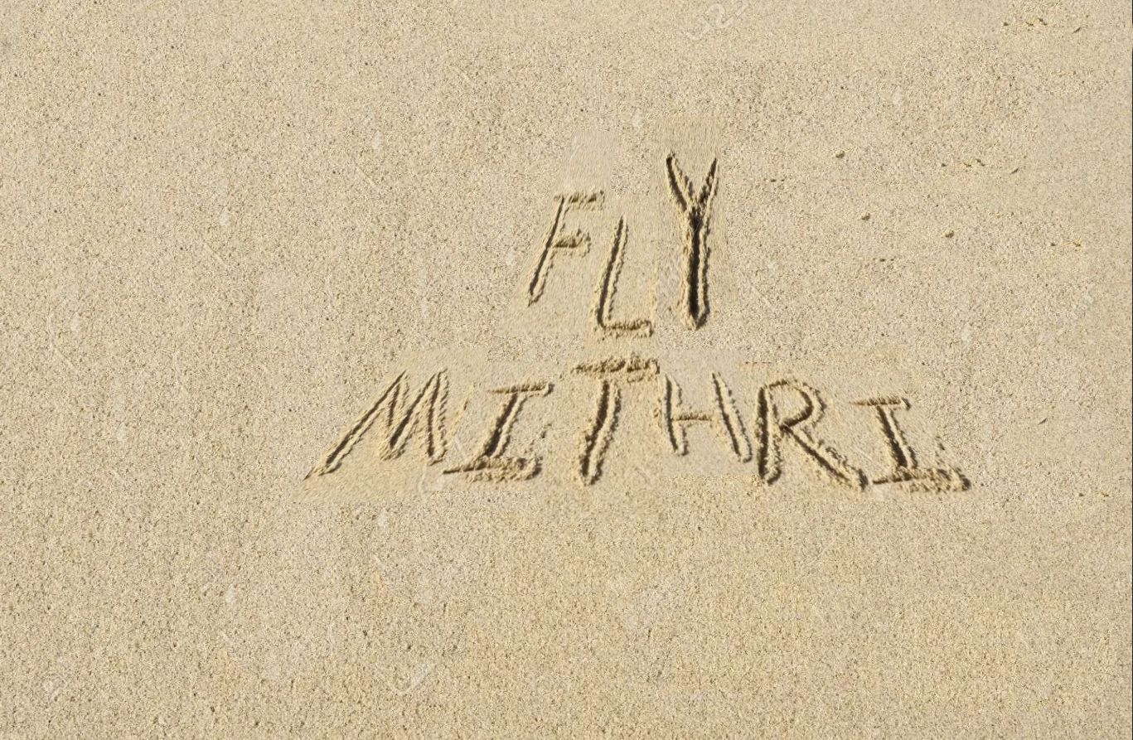
2. Fly Mithridates!, 4th c. B.C.
Mithridates,
read what I wrote on the ground
My goodness!
Thanks Demetrius!
when they were by themselves,
with the sharp butt of his lance
he wrote on the ground …
‘Fly, Mithridates.’
(Plutarch, Demetrius, 4)
Notes:
When he was young Mithridates was hosted at the court of Antigonus. There he and Antigonus’ son, Demetrius, that later took the title “the Besieger”, became very good friends. However, at some point, Antigonus was disturbed by a dream he saw concerning Mithridates and decided to kill him. When Demetrius learned this, he warned his friend with a graffito he made on the ground with the butt of his lance.
when they were by themselves, with the sharp butt of his lance he wrote on the ground …
‘Fly, Mithridates.’(Plutarch, Demetrius, 4)
The graffito made it possible for the two friends to communicate with no words a message that was a matter of life and death for Mithridates. (He flew away and became the king of Pontus in northern Anatolia).

Slide 10
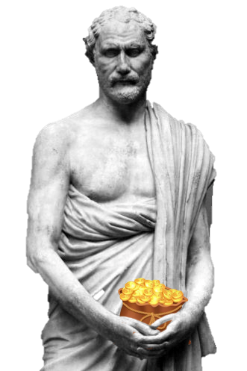
3. “Demosthenes is not bribed” 3rd c. B.C.
whereupon the wits of the city took for a theme the incorruptibility of Demosthenes and vied with one another in their epigrams.
(Plutarch, Demosthenes, 31)
Carlsberg Glyptotek,
Copenhagen
Notes:
Demosthenes in 324 B.C was exiled from Athens with the accusation of bribery. It was not the first time that accusations of this kind weighed upon him. The reputation that he was a bribe-taker followed him even after his death. Plutarch informs us that even his statue received mockery for the same reason by youngsters that vied with one another in their epigrams.
“…whereupon the wits of the city took for a theme the incorruptibility of Demosthenes and vied with one another in their epigrams” (Plutarch, Demosthenes, 31)
It is not stated whether these epigrams took a written form as graffiti, or if they remained oral. However, they share many characteristics of graffiti and they could easily have taken a written/ actually a material the form of graffiti.

Slide 11
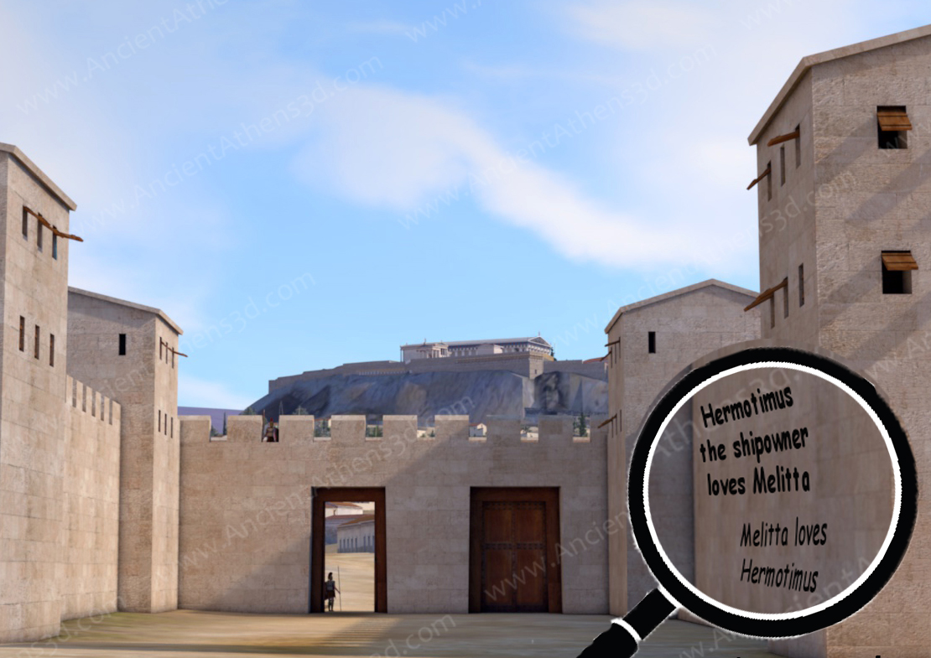
4. “Hermotimus the ship-owner loves Melitta”, 2nd c. A.D.
.. (she saw) chalked up close by the
Dipylus, on the right as you come in:
Melitta loves Hermotimus;
and lower down:
Hermotimus the ship-owner loves Melitta.
(Lucian, Dialogues of the Courtesans, 2-3)
www.AncientAthens3d.com
Notes:
Melitta is a courtesan living in Athens in the 2nd c. A.C. one day her life came upside down due to a graffiti that referring to her name. On the walls of Dipylon in Keramikos appeared the text: "Melitta loves Hermotimos" and a little further down: "The Shipowner Hermotimos loves Melitta". None of these graffiti were written by Melitta, she knew neither who Hermotimos the so called Ship – owner was nor who made these false graffiti against her. Her lover however was convinced that the graffiti were true and started avoiding her.
.. (she saw) chalked up close by the Dipylus, on the right as you come in: Melitta loves Hermotimus; and lower down: Hermotimus the ship-owner loves Melitta.(Lucian, Dialogues of the Courtesans, 2-3)
Here we have a case of false news. Neither Melitta nor Hermotimus seem to have anything to do with the graffiti that are attributed to them. They are graffiti made by others, probably youths that wanted to have fun with a jealous friend, Melitta’s lover.

Slide 12
What the writers think about graffiti of juveniles
Only in classical Athens are juveniles attested to show interest about politics
They make graffiti identical to the ones made by adults
What differs is the place they make them
Anonymous graffiti are made for fun and cause problems to others
Writers don’t seem to approve them
Kings and princes do not hide their identity and save their people through their graffiti
Notes:
Based on only these 4 examples we can reach some preliminary conclusions of what the writers think of juveniles’ graffiti.
- From the figural graffiti made before the Sicilian expedition we conclude that:
Only in classical Athens did juveniles show interest about politics through their graffiti and these were identical to the ones made by adults
- From the graffiti concerning Demosthenes and the courtesan Melitta we conclude that: anonymous graffiti were made for fun and caused problems to others. Writers don’t seem to appreciate or approve them.
- Judging from the graffiti of Demetrius we can conclude that: Kings and princes do not hide their identity when they do a graffito and they make them for a higher purpose. Demetrius saved his friend who later became a king.

Slide 13
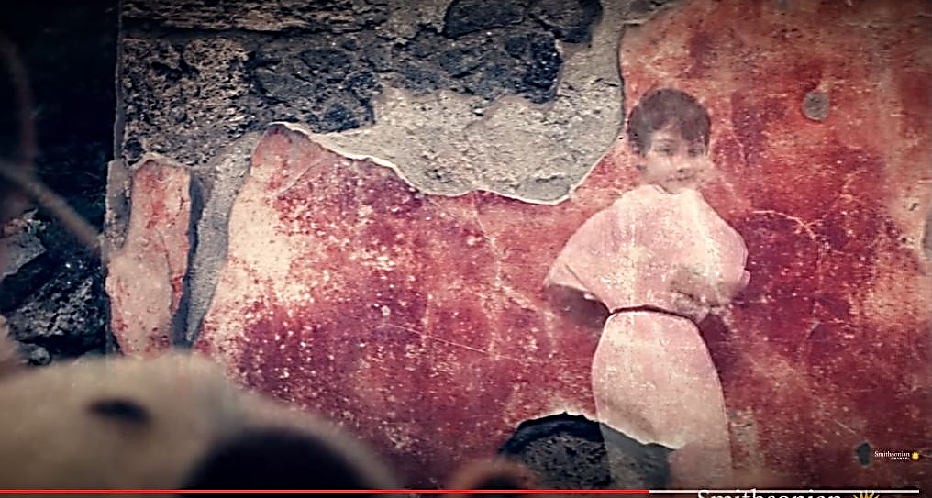
Tracing children’s graffiti
Children's graffiti are expected…
To be found low on the wall
To have crude technique
To have themes linked to childhood
(for figural graffiti)
to evolve according to
Developmental Psychological Rules
https://www.youtube.com/watch?v=Jecm2HnDLaA
Notes:
While in ancient texts it is straight forward to recognize which graffiti are made by children– the writers just say so, in the archaeological record, recognizing children’s graffiti is a bit more complicated. It is difficult to isolate the graffiti of children and juveniles, since what they write isn’t necessarily different from what adults write and graffiti writers seldom indicate their age. In order to trace them we have to take into account other criteria, such as:
- The height of the graffiti on the walls:
when a graffito is made at a low level on the wall it is usually attributed to children. They are not as tall as the adults.
- The “crude" technique (for figural graffiti):
when the design is crude it is usually attributed to children. They are not familiar with writing tools and their designs tend to be unsteady, unnaturalistic and with wrong perspective
- The type of graffiti: some graffiti categories such as carved toys, animal designs, alphabets for learning to write, are often associated to children (Huntley 2011: 71).

Slide 14
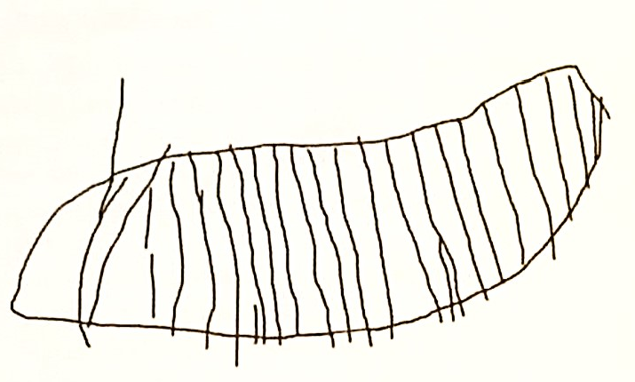
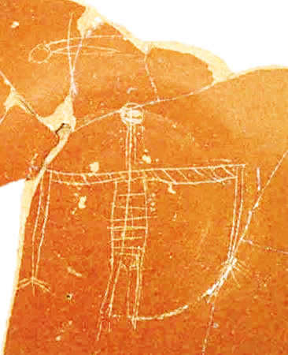
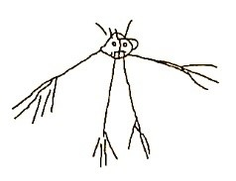
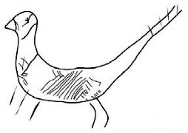
Toddlers’ graffiti (up to 7 years old)
Multiple horizontal and vertical lines within a closed form
Pompei, Casa del Menandro
Huntley 2011: fig. 4.1
Transparent figures
showing parts of the body that should have been hidden
Images, with units radiating outwards.
Pompei, Termopolio dell’Aselline
Huntley 2011: fig. 4.1a
Exaggeration of ‘non-human’
elements
Byzantine Museum of Thessaloniki, ΒΚ. 4493/18
Pompei
Huntley 2011: fig. 4.1d
Notes:
A toddler doesn’t know how to read or write so the only graffiti he/ she can make are figural. In order to trace a child’s hand behind various figural graffiti, we can apply principles of developmental psychology. According to this theory, children’s brains evolve in the same biological way regardless of the era, the region, or the social conditions in which they live. As a result, children of the same developmental stage will perceive the world in the same way and when they try to draw, they will follow unconsciously the same rules. This results in doddles that show common morphological characteristics among children of the same age no matter where, how or when they have lived. Whether they come from Europe or Asia, Pompeii or Athens, whether they live in the present or have lived in the past, they all perceive the word in the same way and depict it in their doddles following the same morphological rules. These rules are “pan-child” and “pan-human”. In other words, children of the same age will make similar drawings. We can see some of the rules according to which figural graffiti from Pompeii, Athens and Thessaloniki are attributed to toddlers. On the left we have examples from Pompeii.
- Closed forms with horizontal and vertical lines
- Images with radiating units – legs or hands- and an emphasis on the facial features
- Exaggeration of non-human elements on animals
- Transparent figures that show parts of the body that should be hidden by the clothes or posture of the figure.

Slide 15
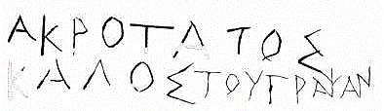
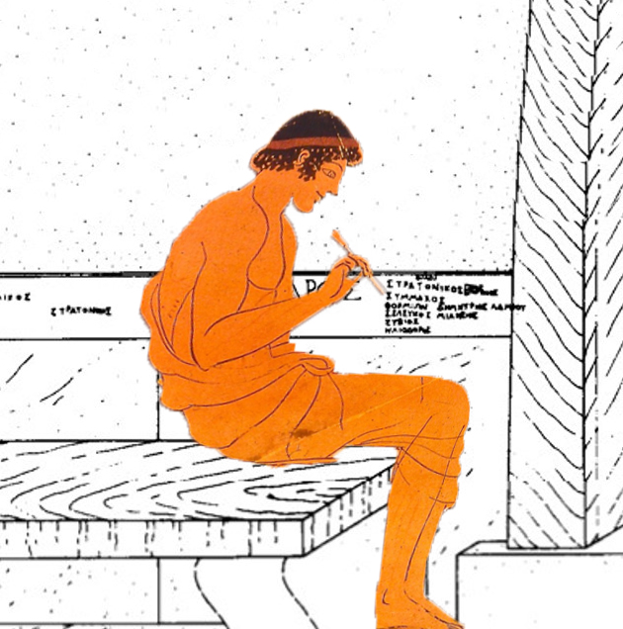
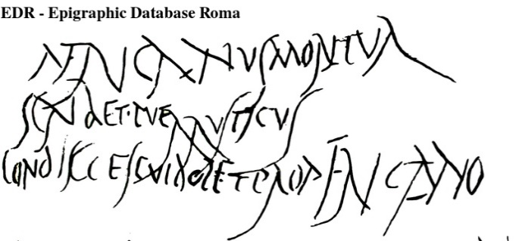
Graffiti of athletes and students (7-18 years old)
Friends:
Stratonicus, Symmachos,
Phormion, Seleucus, Eubius,
Heliodorus (Attica, IG II² 4256)
Miller 1990: 189, fig. 66
Akrotatos is beautiful according to the person who writes (this)
Nemea (Graf 14 C – D)
Africanus is dead
writes a boy, Rusticus
his classmate,
who feels sorry for Africanus
Pompei, CIL 4 2258
http://www.edr-edr.it/edr_programmi/view_img.php?lang=en&id_nr=152017
Notes:
In order to trace graffiti of juveniles 7-18 years old I turned to places where they frequented, namely gymnasia and stadia etch. However, these places were not age- orienteered and were crowded by people of all ages. For this reasons I collected graffiti only from two places where we believe were crowded mostly by juveniles. The first groups was found in the crypt of the stadium in Nemea. It was the entrance, through which young athletes entered the stadium. The second was found in the Pompeion in Athens, a building that served both as a teaching place and a gymnasium. The third groups consists of some graffiti from Pompeii that through their texts give hints about the young age of their writers.
In the Stadion of Nemea, most graffiti characterize athletes as beautiful.
In the Pompeion graffiti indicate the presence of friends. Probably by the end of their studies groups of schoolmates and friends curved their names on the walls close to the benches where they sat attending their lectures.
In Pompei, a schoolmate, Rusticus, expresses his grief on the loss of Africanus, one of his schoolmates.
Taking all into account we see that through their graffiti juveniles attest their presence in certain places. However, that isn’t necessarily their true and only concern. Other kinds of graffiti, such as sexual, political etch., do not have a particular age mark and could well have been done both by youngsters or adults.

Slide 16
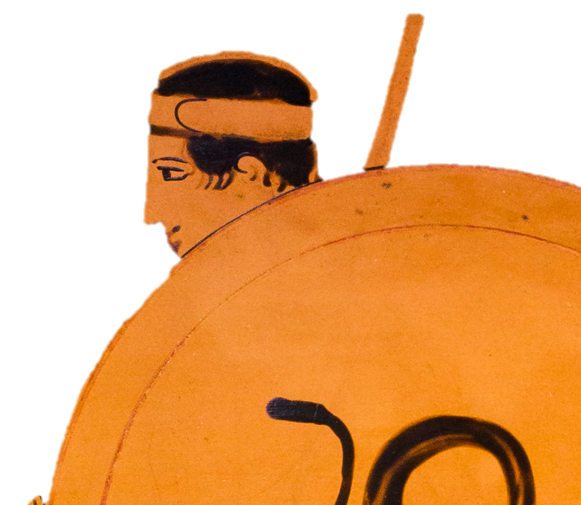
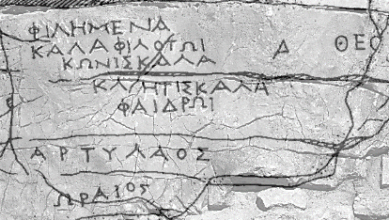
Graffiti before adulthood (18 - 20 years old)
I 6, 1213)
I, Damodorus, love Apollocrates of course, but I burn for Epigonus.
(I write) as I guard the citadel of the Corsians
(Fournoi island, IG XII 6, 1213)
Philotas finds Filemeni beautiful.
Phaedros finds Connie and Kliti nice.
Artilaos is handsome
(Dimaion fortress)
Σούρα 2017: 76, εικ. 7, Σχ. 3
Notes:
Graffiti of the age group 18-20 years old were collected from the islands of Fournoi, Thassos, from Achaia and Pompeii. All of them feature common elements. First of all graffitists are all on their military service. This means that not only are they of the same age, roughly 18-20 years old, but also, they share the same life conditions, the same tasks and duties. One of these duties was to guard remote fortresses for hours and hours and in order to make these very long hours short they carved their thoughts, feelings or comments on the rock.
Very often we find the names of men or women they admired for their beauty like the graffito from Dimeon fortress
“Philotas finds Filemeni beautiful, Faidros finds Connie and Kliti nice……”.
On another example Damodorous as he guards, recollects two people he is attracted to. He is in love with Apollocrates, but he is also attracted to Epigonus.
All these graffiti are testimonies of memories, of love and of friendship. Even though adulthood was very near the political situation of their cities seems not to be their concern.

Slide 17
Children do write graffiti
In antiquity graffiti ….
…accompanied man from a very young age
…followed age centered concerns
…were part of leisure time
…made by graffitist of the same age look very much alike
All ages including children use graffiti to mark their identities and to freely express their concerns
Notes:
Taking all these into account we can now easily answer the main question stated at the beginning of the presentation: “Do children write [graffiti]?” The answer is undoubtedly affirmative. Children do write [graffiti]. Collecting data from two quite different sources – the archaeological record and the literary testimonia- we can draw conclusions that complete one another.
The archaeological record testifies that graffiti:
- accompanied man from a very young age
- follow age centered concerns
- are part of leisure time
- made by graffitist of the same age look very much alike
All ages including adults use graffiti to mark their identities and to freely express their concerns

Slide 18
Bibliography
Hunink, V. 2014: Oh Happy place. Pompeii in 1000 graffiti, Apeiron Editori.
Huntley, Κ. 2017: The writing on the wall. Age, agency and material culture in Roman Campania, in Laes, Chr. & Vulanto, V. (eds.) Children and everyday life in the roma and late antique world, Routledge, London and New York, pp. 137- 154.
Huntley, K. 2012: Identifying Children’s Graffiti in Roman Campania: A Developmental Psychological Approach», στο Baird, J. & Taylor Cl. (eds): Ancient Graffiti in Context, Routledge, pp.69-89.
Lang, M. 1976: The Athenian Agora, Vol. XXI: Graffiti and dipinti, The American School of Classical Studies at Athens, Princeton, New Jersey.
Lohmann, P. 2018: Graffiti als Interaktionsform, geritzte Inschriften in den Wohnhäusern Pompejis, De Gruyter, Berlin/Boston.
Loraux N. 2008: Οι εμπειρίες του Τειρεσία, το θηλυκό στοιχείο και ο άντρας στην αρχαία Ελλάδα, εκδ. Πατάκης, Αθήνα.
Stroszeck, J. 2017: Ο Κεραμεικός των Αθηνών. Ιστορία και μνημεία εντός του αρχαιολογικού χώρου, εκδ. Bibliopolis, Αθήνα.
Θέμου, Α 2014: Ἀπόρρητοι ἐπιγραφαί. Αρχαίες ελληνικές ερωτικές επιγραφές, Διδ. Διατριβή, Εκπα.
Σκίτσα, Α. ….: (55) Γραπτές και εγχάρακτες επιγραφές από τον διθάλαμο Μακεδονικό Τάφο Δ του Ανατολικού Νεκροταφείου Πέλλας, Τόμος ΘΙΝΚ υπό έκδοση
Δασκαλάκη 2010-2013: 22-25, 179-186

