Slide 1
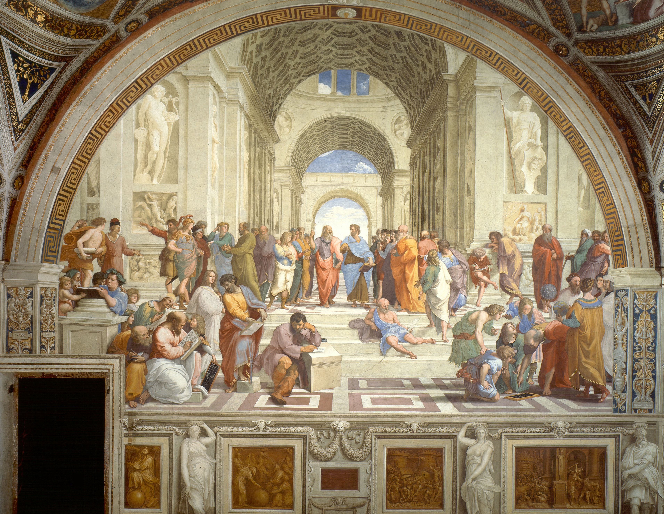

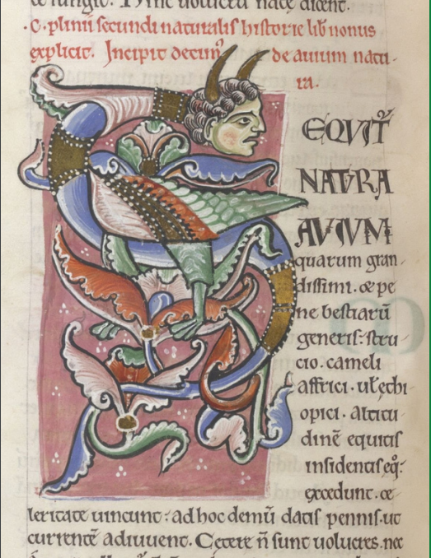
Plato’s Divine Comedy
Editare interpretare commentare. Approcci multiformi al testo letterario
Editing Commenting Interpreting. Multifarious Approaches to Literary Text
IX Edtion- Rome, September 30th 2022 (II session)
Elena Sofia CAPRA (She/her) – Università di Roma «Tor Vergata»
The Comic, Epic and Historical Catabasis of the Protagoras

Slide 2
The Protagoras: essential data
Composition date: ’90s or ‘80s of the 4th century (links to Laches, Gorgias, Meno)
Tetralogy: 6 (Euthydemus, Protagoras, Gorgias, Meno)
Dramatic date: right before the Peloponnesian War (problematic since antiquity)
Interlocutors: Socrates & his friend → Socrates, Hippocrates of Athens, the doorman, Protagoras, Callias, Prodicus, Alcibiades, Critias, Hippias
Main topic: the sophistic education

Slide 3
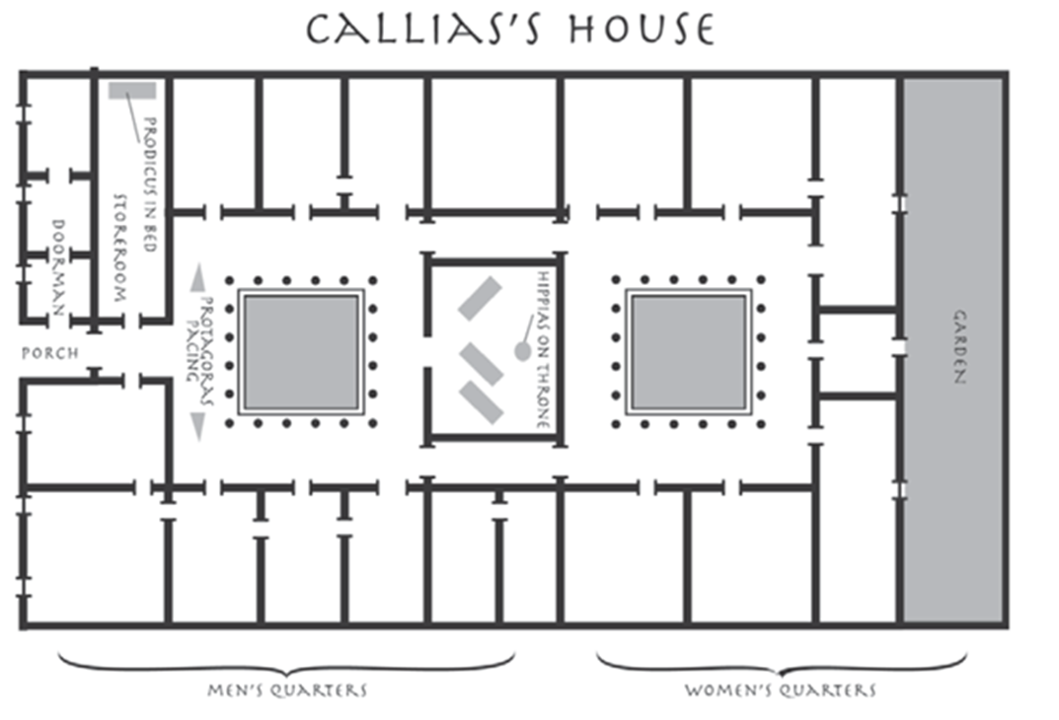
A closer look: Prt. 314 c – 316 a
Image from Arieti, James A. - Barrus, Roger M. (edd.). Plato’s Protagoras: Translation, Commentary, and Appendices. Lanham 2010, p. 112.
Socrates and Hippocrates enter the house of Callias despite the doorman’s opposition (314 c-e)
Protagoras is walking with his disciples and admirers (314 e – 315 b)
Hippias is lecturing his admirers (315 c)
Prodicus, still in bed, is assisted by his admirers (315 d – 316 a)
With the arrival of Alcibiades and Critias the discussion can begin (316 a)

Slide 4
Paper outline
1.
A philosophical comedy
2.
A new Odyssean catabasis
3.
A historical fiction

Slide 5
A Philosophical Comedy
1.

Slide 6
Comic aspects in the Protagoras
House of Callias
Eupolis’ Kolakes (Flatterers)
Use of characters
E. g. the bed of Prodicus: Cratinus’ Panoptai
See Aristophanes, Birds 284 ff.
The eunuch doorman
Change of setting
See Aristophanes, Acharnians 395 ff. (esp. 406-408)
Agonal structure
Individualized choros: Ameipsias’ Konnos
Comic characters: e. g. Aristophanes’ Thesmoforiazusae (Agathon), Strattis’ Pausanias
See Aristophanes, Clouds 131 ff.
Aristophanes’ Clouds:
analogy & opposition

Slide 7
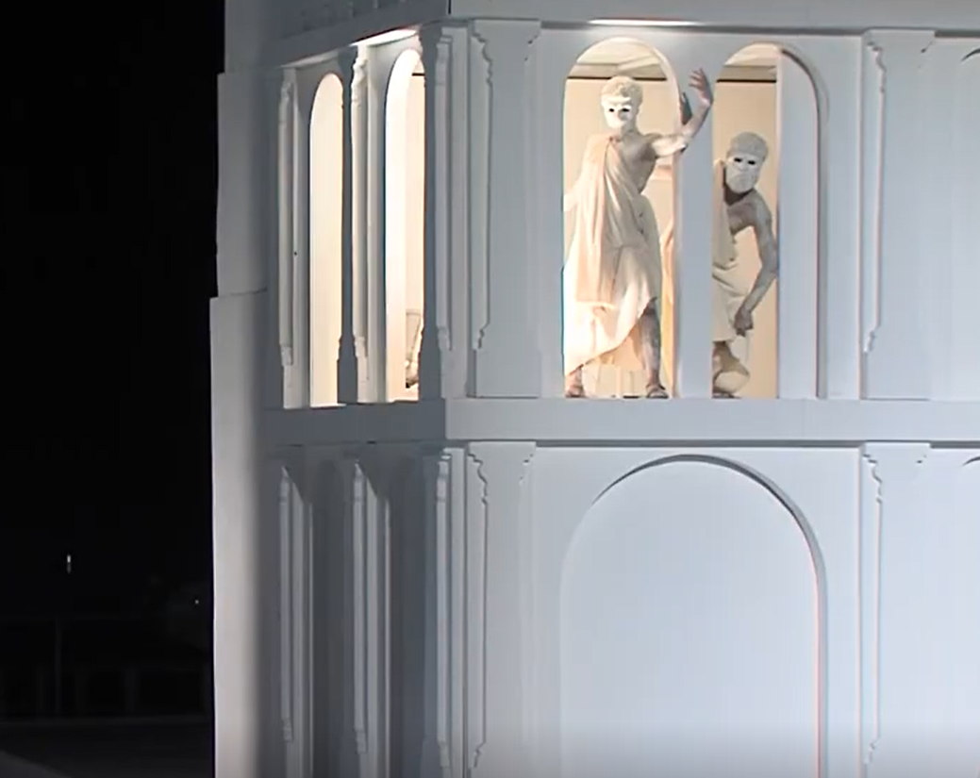
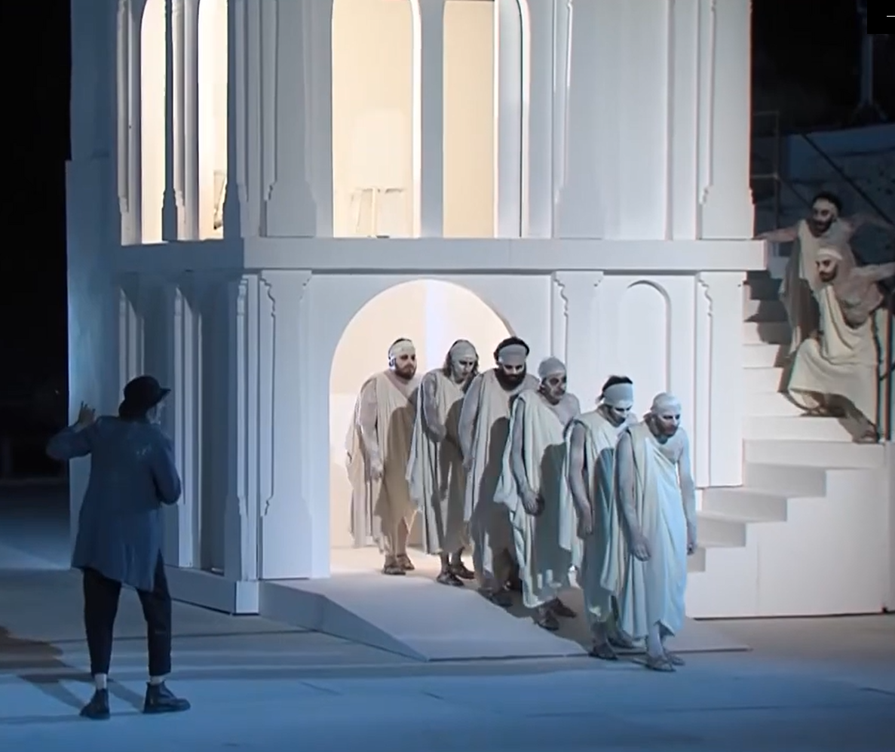
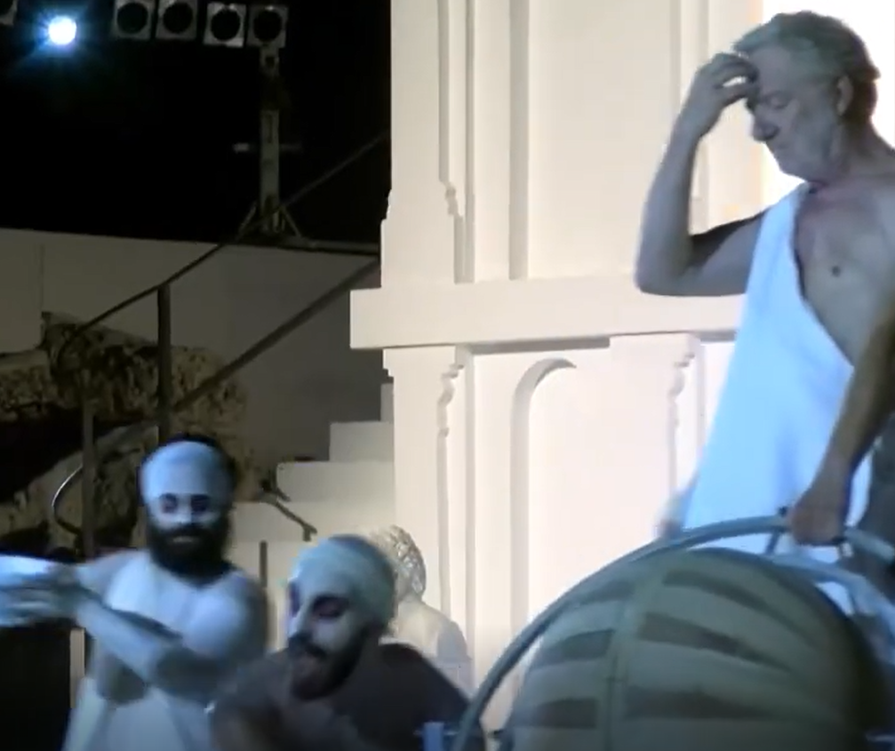
The parodos (315b)
Screenshots from Nuvole, directed by Antonio Calenda for INDA, Siracusa 2021
(filmed version: https://www.youtube.com/watch?v=UrxRF7GlS00, last visit on 2nd April 2022)
τοῦτον τὸν χορὸν μάλιστα ἔγωγε ἰδὼν ἥσθην, ὡς καλῶς ηὐλαβοῦντο μηδέποτε ἐμποδὼν ἐν τῷ πρόσθεν εἶναι Πρωταγόρου, ἀλλ’ ἐπειδὴ αὐτὸς ἀναστρέφοι καὶ οἱ μετ’ ἐκείνου, εὖ πως καὶ ἐν κόσμῳ περιεσχίζοντο οὗτοι οἱ ἐπήκοοι ἔνθεν καὶ ἔνθεν, καὶ ἐν κύκλῳ περιιόντες ἀεὶ εἰς τὸ ὄπισθεν καθίσταντο κάλλιστα.
The dance of this chorus simply delighted me when I saw how beautifully they took care never to get in Protagoras’ way. When he turned around with his flanking groups, the audience to the rear would split into two in a very orderly way and then circle around to either side and form up again behind him. It was quite lovely.
See Alexis, fr. 151 K-A = 147 K

Slide 8
A New Odyssean Catabasis
2.

Slide 9
Explicit quotation (315 b-c) - 1
Τὸν δὲ μετ’ εἰσενόησα, ἔφη Ὅμηρος, Ἱππίαν τὸν Ἠλεῖον, καθήμενον ἐν τῷ κατ’ ἀντικρὺ προστῴῳ ἐν θρόνῳ·
And then I perceived (as Homer says) Hippias of Elis, on a high seat in the other side of the colonnade.
τὸν δὲ μέτ’ εἰσενόησα βίην Ἡρακληείην,
εἴδωλον·
After him I became aware of powerful Hēraklēs, his phantom
Odyssey XI 601-602; see also XI 572

Slide 10
Explicit quotation (315 b-c) - 2
Καὶ μὲν δὴ καὶ Τάνταλόν γε εἰσεῖδον—ἐπεδήμει γὰρ ἄρα καὶ Πρόδικος ὁ Κεῖος.
And not only that, but I saw Tantalus too, for Prodicus of Ceos was also in town.
καὶ μὴν Τάνταλον εἰσεῖδον χαλέπ’ ἄλγε’ ἔχοντα
I also saw Tantalos suffering painful torment
Odyssey XI 582

Slide 11
Other references and analogies
First-person narrative
Protagoras ὥσπερ Ὀρφεύς (315 b)
Chtonic inferences of the passage through the door / the doorman
Structural correspondences Socrates/Odysseus, Socrates/Hermes, Protagoras/Circe, Protagoras/Tiresias
Explicit Homeric citation in the frame of the Protagoras
Prt. 309 a-b (Alcibiades) → Iliad XXIV 348; Odyssey X 279 (Hermes)
See Euripides, Alcestis 357–362 (Admetus speaking); Plato, Symposium 179 d (Phaedrus speaking)
E. g. Odysseus ἀκήλητος (Odyssey X 329) vs Protagoras κηλῶν τῇ φωνῇ

Slide 12
Between Comedy and Epic
Τίς γὰρ ἐστιν ὁ λέγων «Καὶ μὴν Τάνταλον εἰσεῖδον» καὶ «Τὸν δὲ μέτ’ εἰσενόησα»; οὐκοῦν ἐκείνους μὲν διὰ τῶν Ὁμήρου κωμῳδεῖ, Ὅμηρον δ’ αὖ δι’ ἐκείνων;
For who is it who says «And I saw Tantalus» and «After him I recognized»? Does he not satirize them through Homer’s words and again Homer through them?
Aelius Aristides, To Capito (The Third Platonic Discourse), 329 Jebb

Slide 13
A Historical Fiction
3.

Slide 14
X
Socrates
Hippocrates
Protagoras
Callias
Paralus
Charmides
Xanthippus
Philippides
Antimoerus
Hippias
Eryximachus
Phaedrus
Andron
Prodicus
Pausanias
Agathon
Adeimantus son of Cepis
Adeimantus son of Leucolophides
X
Alcibiades
Critias
All the characters of Charmides and Symposium,
but Aristophanes

Slide 15
τῶνδε δὲ οὔπω ἄξιον τοῦτο κατηγορεῖν· ἔτι γὰρ ἐν αὐτοῖς εἰσιν ἐλπίδες· νέοι γάρ.
But it is not fair to accuse these two yet; there is still hope for them, for they are young.

Slide 16
Conclusions

Slide 17
Comic imagery
Setting, situations, characters’ gestures, use of epic quotations
a philosophical ἀγών about virtue and education
Socrates’ catabasis
Emphasis on door and passage, echoes of mythical and Homeric catabaseis
a voyage in an Otherworld full of dead people and useless hope
Portrait of a generation
Careful choice of characters, emphasis on the house of Pericles and on genealogical themes
a personal and philosophical interpretation of the crisis of Pericles’ Athens

Slide 18
E, come ben si sa, viventi o persone della recente vita politica popolano la commedia (mentre la tragedia si esprime attraverso i giganteschi pupi del mito): e popolano i dialoghi di Platone.
Nel che consiste, come nella Commedia dantesca, una delle più grandi innovazioni dell'imponente corpus drammaturgico costituito dai dialoghi di Platone.
Luciano Canfora, La crisi dell’utopia, p. 13 (my translation)
And, as is well known, living people or people from political life inhabit comedy (whereas tragedy expresses itself through the giant puppets of myth): and they inhabit Plato's dialogues. This consists, as in Dante's Commedia, of one of the greatest innovations of the impressive dramaturgical corpus constituted by Plato's dialogues.

Slide 19

Thank you for your attention!
Elena Sofia Capra - elenasofia.capra@gmail.com

