Slide 1
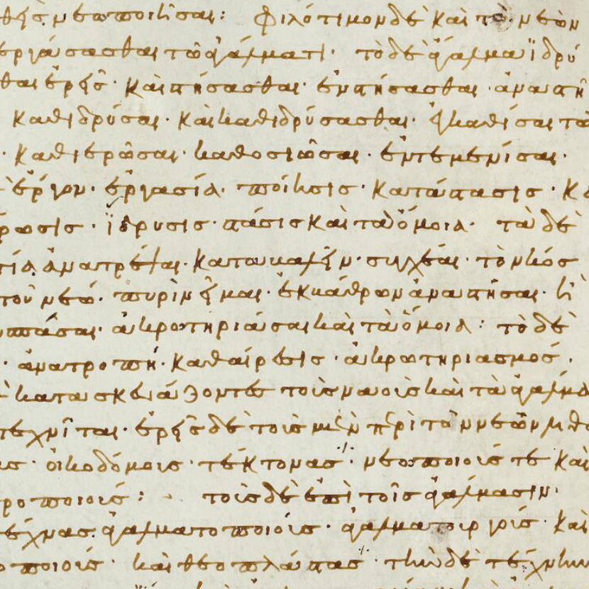
Aristophanes out of Context
An experiment with
hypothetical fragmentation
Clara Brügner M. Ed.
Johannes Gutenberg-Universiät (Mainz)
Editing Commenting Interpreting. Multifarious Approaches to Literary Text. IX Edition
29th September 2022

Slide 2
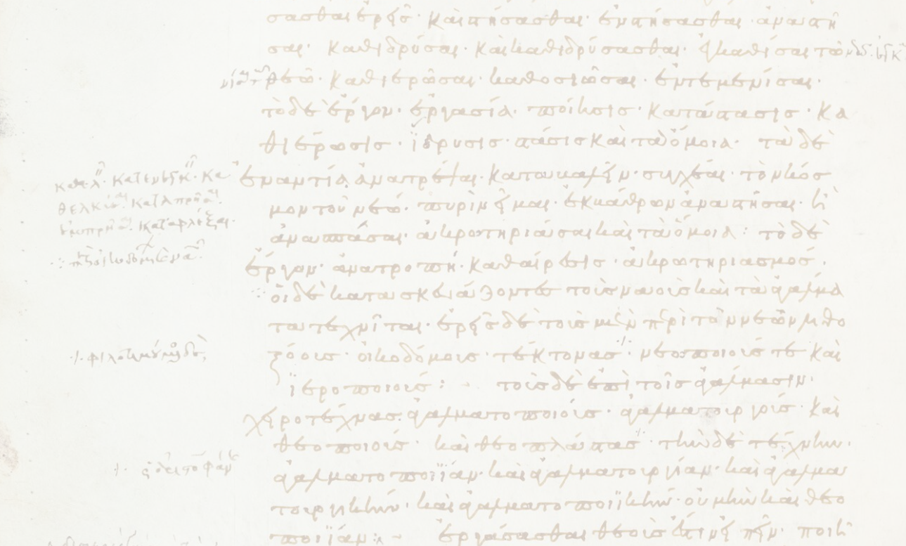
Comic fragments and indirect tradition
Iulius Pollux of Naukratis (2nd c. AD): Onomastikon
Pollux X 102
[…] ἀντλία· τὴν γὰρ σκάφην οὕτως ὠνόμασεν Ἀριστοφάνης ἐν Εἰρήνῃ.
“antlía: Aristophanes uses this term to denote
the skáphe (bowl, kneading-trough, bakerʼs tray) in Peace”.
Aristophanes Pax 17 f.
Οι^{β}. οὐ γὰρ ἔθʼ οἷός τʼ εἴμʼ ὑπερέχειν τῆς ἀντλίας.
Οι^{α}. αὐτὴν ἄρʼ οἴσω συλλαβὼν τὴν ἀντλίαν.
Servant b: “I can no longer get the bilge water under control ( = handle this situation).
Servant a: “Then I will take this bucket of filth and then bring it [to the dung beetle]”.

Slide 3
My thesis: an experiment with hypothetical fragmentation
quotations in Iulius Polluxʼ Onomastikon
extant (!) comedies of Aristophanes
Comparison
a) formal correctness
e.g. morphology, omitted or added words, metre
b) validity of contextual information
c) potential for reconstruction
Evaluation of the indirect traditionʼs impact on fragments and the quality of fragments provided by a specific author
Methodological pitfalls: artificiality & selectivity
Dover, Kenneth J.: Foreword: Frogments, in: Harvey, D./Wilkins, J. (edd.),
The Rivals of Aristo­phanes, Studies in Athenian Old Comedy, London 2000, xvii–xix:
Randomly chosen citations of one play (Frogs) in several sources

Slide 4
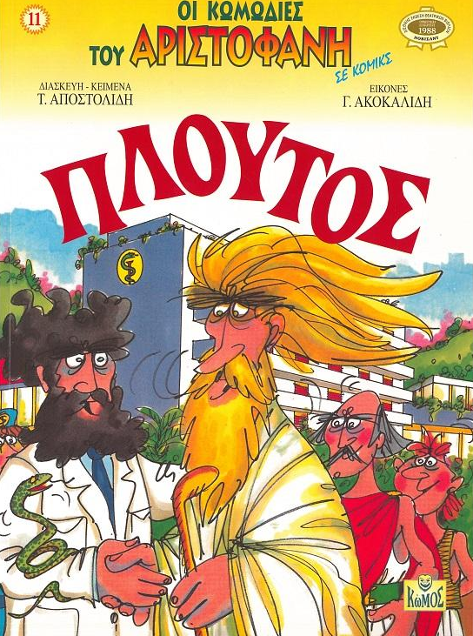
Aristophanes, Ploutos ca. 388 BC
Τάσος Αποστολίδης/Γιώργος Ακοκαλίδης
Οι κωμωδίες του Αριστοφάνου σε κόμικς 11. Πλούτος (2006)

Slide 5
Pollux X 48 – Aristophanes, Ploutos 545 f.
Poll.
καὶ θρᾶνοι δὲ δίφροι ἂν εἶναι δοκοῖεν, εἰπόντος ἐν Πλούτῳ Ἀριστοφάνους
ἀντι δὲ θράνου στάμνου κεφαλὴν κατεαγότος, ἀντὶ δὲ μάκτρας πιθάκνης πλευρὰν ἐρρωγυῖαν.
“but instead of a seat the broken rim of a vessel,
instead of a kneading-trough the broken stave of a cask”
economic-ethical discourse: rich vs. poor
Ar.
Χρεμύλος […]
ἀντὶ δὲ θράνου στάμνου κεφαλὴν κατεαγότος, ἀντὶ δὲ μάκτρας
φιδάκνης πλευρὰν ἐρρωγυῖαν καὶ ταύτην. ἆρά γε πολλῶν […]

Slide 6
Pollux II 59 – Aristophanes, Ploutos 635
Poll.
ἐξωμματῶσθαί φησιν Ἀριστοφάνης τὸν Πλοῦτον ἐν Ἀσκληπιοῦ.
“Aristophanes says that Ploutos has been restored to sight in the temple of Asklepios”
(→ the protagonistʼs utopian plan?)
Ar.
Καρίων […]
ὁ δεσπότης πέπραγεν εὐτυχέστατα,
μᾶλλον δʼ ὁ Πλοῦτος αὐτός· ἀντὶ γὰρ τυφλοῦ
ἐξωμμάτωται καὶ λελάμπρυνται κόρας,
Ἀσκληπιοῦ παιῶνος εὐμενοῦς τυχών.
Karion: “My master has had the greatest of good fortune – or rather Ploutos himself has: instead of being blind, he has been restored to sight and his eyes are sparkling because he found the healer Asklepios in a benevolent mood.”

Slide 7
Pollux VII 71 – Aristophanes, Ploutos 729 f.
Poll.
τὸ δὲ ἡμιτύβιον, ἔστι μὲν καὶ τοῦτο Αἰγύπτιον, εἴη δʼ ἂν κατὰ τὸ ἐν τῇ μέσῃ κωμῳδίᾳ καψιδρώτιον καλούμενον, νῦν σουδάριον ὀνομάζεται· Ἀριστοφάνει γὰρ ἐν Πλούτῳ τοιαύτη τις ἡ δόξα· ἔπειτα καθαρὸν ἡμιτύβιον λαβών τὰ βλέφαρα περιέψεσεν.
“Then, he took a clean wiping cloth and afterwards wiped around the eyelids in circular motion.”
medical treatment of eyes, by human doctor?
Ar.
Καρίων […]
ἔπειτα καθαρὸν ἡμιτύβιον λαβὼν
τὰ βλέφαρα περιέψησεν· ἡ Πανάκεια δὲ […]

Slide 8
Pollux X 103 – Aristophanes, Ploutos 710
Poll.
τὴν δὲ θυΐαν καὶ θυΐδιον εἴποις ἂν κατʼ Ἀριστοφάνην ἐν Πλούτῳ λέγοντα·
“You may call the θυΐα (mortar) θυΐδιον (small mortar) like Aristophanes does in Ploutos.”
→ mortar for medicine production (?? could be linked to other contexts as well)
Ar.
Καρίων […]
ἔπειτα παῖς αὐτῷ λίθινον θυείδιον
παρέθηκε καὶ δοίδυκα καὶ κιβώτιον. […]
πρῶτον δὲ πάντων τῷ Νεοκλείδῃ φάρμακον
καταπλαστὸν ἐνεχείρησε τρίβειν, ἐμβαλὼν
σκορόδων κεφαλὰς τρεῖς Τηνίων. ἔπειτʼ ἔφλα
ἐν τῇ θυείᾳ συμπαραμειγνύων ὀπὸν
καὶ σχῖνον. εἶτ᾽ ὄξει διέμενος Σφηττίῳ
κατέπλασεν αὐτοῦ τὰ βλέφαρ᾽ […]
z
Karion: “Then a boy set beside him a stone mortar, pestle, and medicine-chest. […] First of all he set to work to pound a medical plaster for Neokleides. He threw three heads of Tenos garlic into the mortar and crushed them, mixing in
fig-juice and mastic with them, and then he soaked the lot with Sphettian vinegar and plastered his eyes with it.”

Slide 9
Pollux IX 101 – Aristophanes, Ploutos 816
Poll.
οἱ δὲ καὶ ἀργυρίῳ πράττειν ἠξίουν, εἰ πιστὸς Ἀριστοφάνης ἐν Πλούτῳ λέγων στατῆρσι δʼ οἱ θεράποντες ἀρτιάζομεν.
“some also thought that it would be a good idea to do so [play ‘odd or even’] with money,
if Aristophanes is trustworthy when he says in Ploutos: We, the servants, play the game ‘odd or even’ with staters.” Pollux does not know the original context
speaking role of a servant whose household is extraordinarily rich
Ar.
Κα. […]
στατῆρσι δʼ οἱ θεράποντες ἀρτιάζομεν
χρυσοῖς· […]
z“We, the servants, play the game ‘odd or even’ with golden staters”
z

Slide 10
Comparison with Ploutos in Athenaiosʼ Deipnosophistai
Olson, S. Douglas: Athenaeusʼ Aristophanes and the Problem of Reconstructing Lost Comedies, in: Chronopoulos, Stylianos/Orth, Christian (edd.): Fragmente einer Geschichte der griechischen Komödie, Freiburg 2015, 35–55.
Ath. 6.229 e
ἐν τῷ Πλούτῳ δράματι κατὰ τὴν τοῦ ὁμωνύμου θεοῦ ἐπιφάνειαν τοὺς ἰχθυηρούς φησι πίνακας ἀργυροῦς ἀναφανῆναι καθάπερ καὶ τὰ ἄλλα ἅπαντα.
“In the play Ploutos he [Aristophanes] says that when the god by the same name appeared, the fish-platters were discovered to be silver, like everything else”.
evidence provided by Athenaios
Ploutos appears and makes people rich
luxurious tableware
a speaker who used to eat anything out of poverty (but became rich?)
a speaker who is sad because he used to eat ham (but became poor?)
Sphettian vinegar
evidence provided by Pollux
Ploutos has regained sight in the temple of Asklepios (→ the protagonistʼs utopian plan?)
socio-economical discourse: rich vs. poor
medical treatment of eyes, by human doctor?
mortar for medicine production (?? could be linked to other contexts as well)
speaking role of a servant whose household is extraordinarily rich

Slide 11
Conclusion
Pollux quotes indirectly: The context in the Onomastikon might be misleading
Less one-sided citations than in Athenaiosʼ Deipnosophistai
Connections to central plot elements
→ Reevaluate the importance of Pollux (and other providers of fragments)
Plot significance and context of most true fragments remains unclear
What can be reconstructed, if not the plot?

